Slide 2


Slide 3
MACHINE LEARNING:
HR Analytics
Team Members MSBA-Section A:
Anuja Dixit, Matthew Lock, Kathleen Sebastian, Supriya Shahane, Arpita Sharda, Tatiksha Singh
Notes:
KATHLEEN

Slide 4
WHY SHOULD WE CARE?
EMPLOYEES
considering a SWITCHING JOBS
Source: GallUP
FEELING DISCONTENT AT WORK
Source: SHRM
51%
50%-60%
Notes:
KATHLEEN
https://www.talentlyft.com/en/blog/article/245/7-interesting-facts-about-employee-turnover-infographic-included

Slide 5
WHY SHOULD WE CARE?
EMPLOYERS
Have employee retention as a top priority
Source: Future Workplace & kronos
HR leaders say employee burnout is responsible for up to 50% of their annual workforce turnover
Source: Bonus.ly
87%
46%
Notes:
KATHLEEN
https://www.talentlyft.com/en/blog/article/245/7-interesting-facts-about-employee-turnover-infographic-included
https://blog.bonus.ly/10-surprising-employee-retention-statistics-you-need-to-know

Slide 6
04 Next Steps
01 INTRODUCTION & OBJECTIVES
02 Exploratory Data analysis
03 Models & Key insights
Notes:
KATHLEEN

Slide 7
INTRODUCTION & OBJECTIVE
Notes:
KATHLEEN

Slide 8
OBJECTIVES
Identify Major Factors contributing to employee churn
PREDICT THE EMPLOYEES MOST LIKELY to LEAVE
1
2
Notes:
KATHLEEN

Slide 9
HR ANALYTICS DATASET - KAGGLE
SOURCE: Kaggle
CONTEXT: Employee profiles of a large company, each row represents a record for an employee
COLUMNS:
Satisfaction Level
Last Evaluation
Number Project
Average Monthly Hours
Time Spend Company
Work Accident
Left Company
Promotion Last 5 Years
Department
Salary

Slide 10
2. Exploratory Data analysis

Slide 11
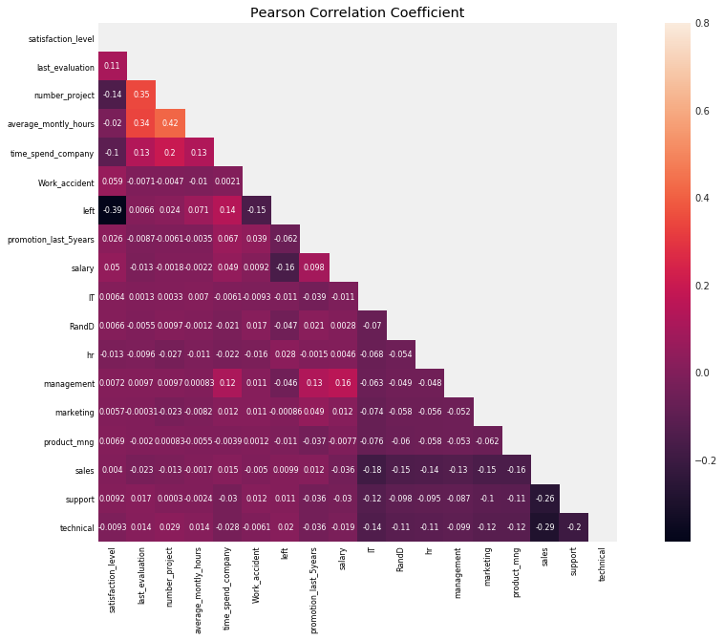
Exploratory data analysis
Top 4 Contributors for Employee Turnover
Satisfaction Level
Work Accidents
Salary
Time Spent at Company

Slide 12
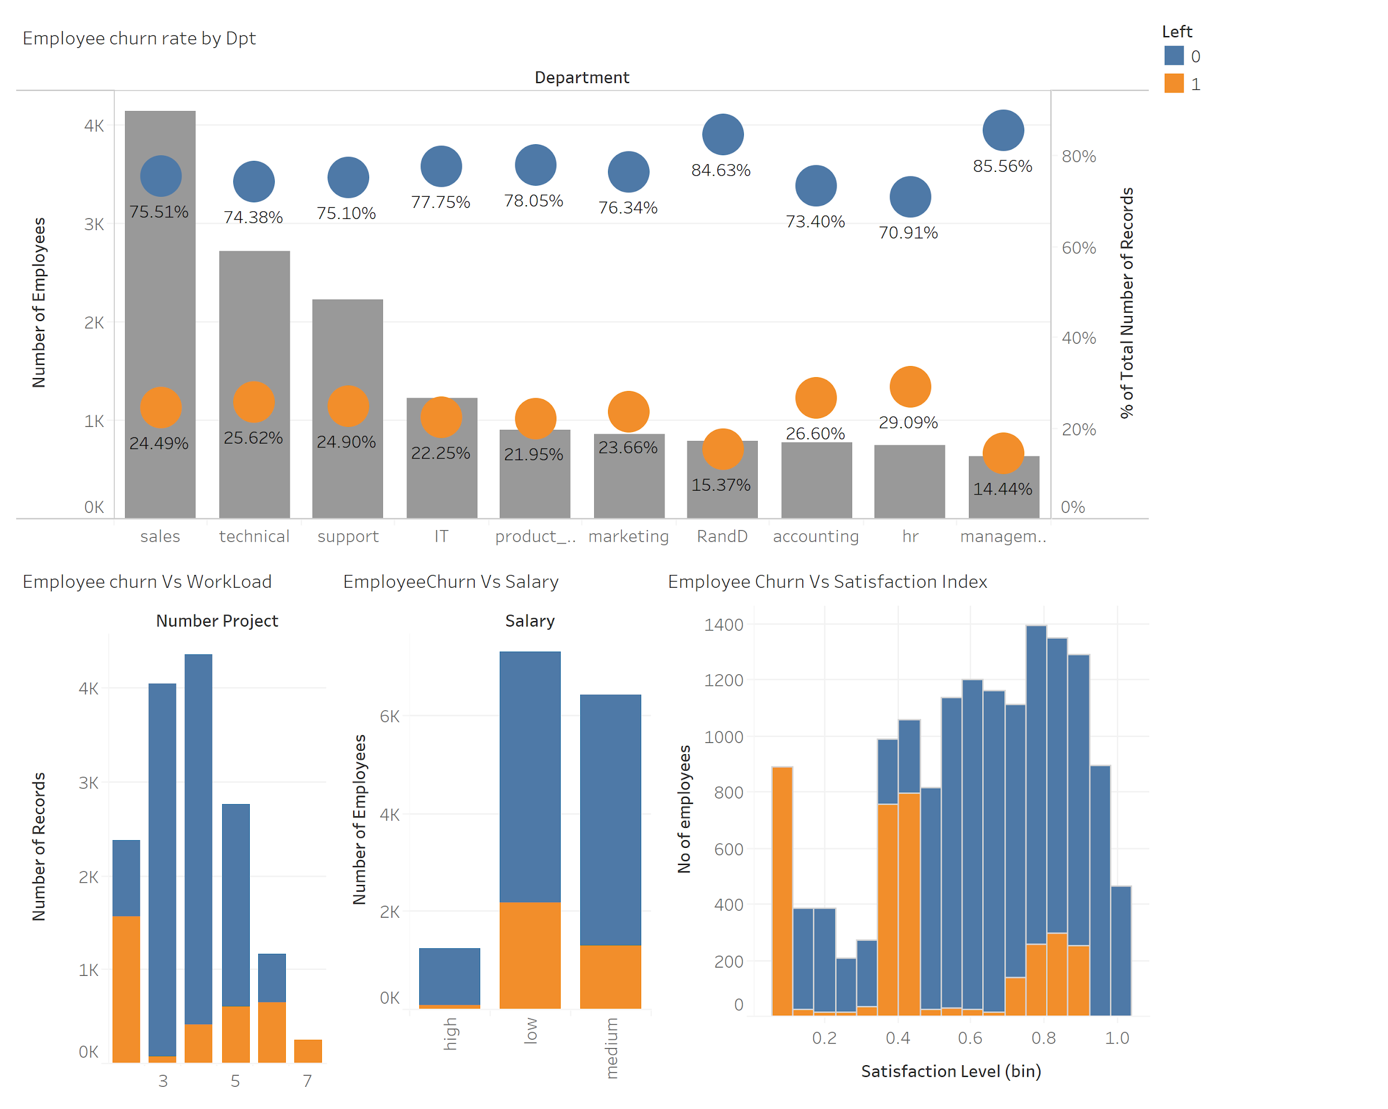
Exploratory data analysis
Large variability in satisfaction level
~55% ex-employees have satisfaction level less than 0.5
Employee churn rate across departments varies from 14% to 30% with the minimum churn rate of ~14% for Management and maximum of ~30% for HR.
Large fraction of low salary employees churned
Notes:
Most of the employees who leave have got a satisfaction index ranging from 0.1-0.5. Satisfaction index is one of the strongest indicator of employee churn.

Slide 13
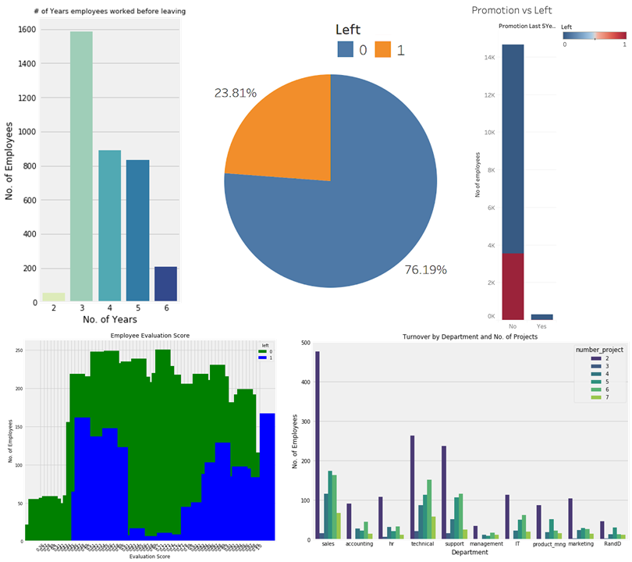
Exploratory data analysis
23.81% current attrition rate for the company.
Employees left after 3 years regardless of promotion
Max 6 years w/o promotion
~24% Employees that did not get promotions, left the company
Most ex-employees had 2 projects
Large variability in evaluation score
Top 3 Departments where employees left:
Sales
Technical
Support

Slide 14
3. Models & Key Insights

Slide 15
WEKA MODEL SUMMARY
Decision Tree |  |  |  |  | Logistic Regression
Pre-processing | Sampling | ROC curve | Recall | Accuracy | ROC curve | Recall | Accuracy
Benchmark | 80/20 | 97.90% | 94.30% | 97.77% | 80.80% | 36.00% | 79.70%
 | 10 fold | 98.00% | 95.80% | 98.03% | 77.60% | 26.50% | 79.50%
Bins = 10/ Unpruned | 10 fold | 97.40% | 95.00% | 97.03%
Bins = 10/ Pruned | 10 fold | 95.90% | 89.90% | 96.55%
Bins by freq/ Unpruned | 10 fold | 97.20% | 95.0%% | 96.90%
Bins by freq/ Pruned | 10 fold | 95.80% | 90.10% | 96.57%
Bins by freq/ Unpruned / instancesperleaf = 20 | 10 fold | 97.90% | 89.80% | 96.31%
Bins by freq/ Pruned / instancesperleaf = 20 | 10 fold | 89.10% | 96.10% | 96.21%
Normalize | 10 fold |  |  |  | 77.50% | 26.40% | 79.57%

Slide 16
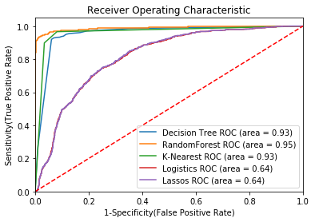
Python MODEL SUMMARY
Scoring Criteria | Decision Tree Classifier | Logistic Regression | Random Forest | KNearest Neighbor | Support Vector Machine | Lasso Regression
Precision | 92.4% | 61% | 99% | 89% | 55% | 49%
Recall | 96.3% | 36% | 91% | 90% | 25% | 25%
Accuracy | 97.7% | 79% | 98% | 95% | 77% | 76%

Slide 17
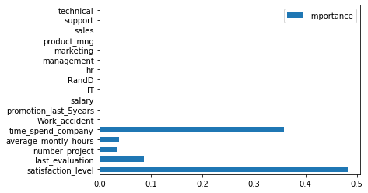
Python MODEL SUMMARY - feature importance

Slide 18
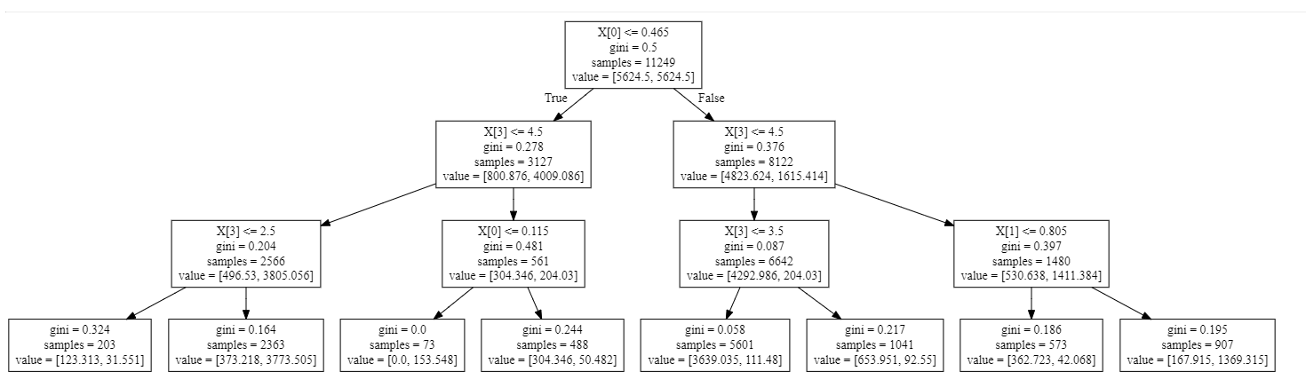
MODEL SELECTION - DECISION TREE
Satisfaction level is the most important feature determining the future of an employee in the company
Employees with satisfaction level > 0.465 and time spent in the company > 4.5 years and whose rating from last evaluation is > 0.805 are very less likely to leave the company
Employees with satisfaction level < 0.465 and time spent in the company < 2.5 years are most likely to leave the company
Satisfaction Level
Time spent in company
Time spent in company
Last Evaluation
Time spent in company
Satisfaction Level
Time spent in company
Left = 1
Left = 0
Notes:
X0=satisfaction level
X1= last evaluation
X3= time_spend_company

Slide 19
4. NEXT STEPS

Slide 20
NEXT STEPS
Design Employee retention methods that address the factors contributing to employee attrition
Conduct further analysis for motivations of employees leaving to see if it was their choice or if they were laid off or fired
Distribute list of employees to HR managers who are about to leave
Communicate factors influencing employees decision to leave

Slide 21
THANK YOU! Any questions?

Slide 22
APPENDIX

Slide 23


Slide 24

Notes:
AND THIS IS CURRENTLY THE STAT

Slide 25
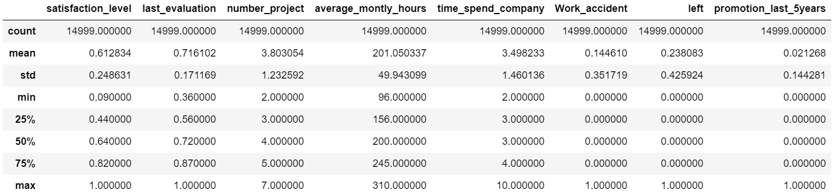
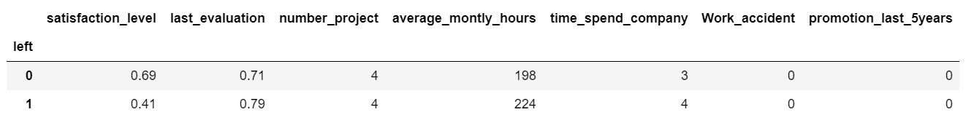
DESCRIPTIVE STATISTICS
Median Values

Slide 26
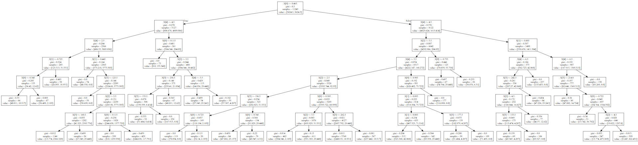
MODEL SELECTION - DECISION TREE (LEVEL 7)

Slide 27
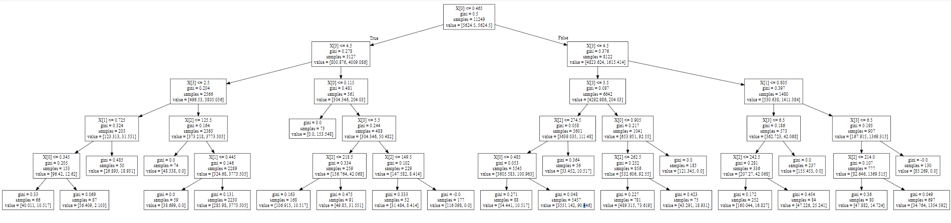
MODEL SELECTION WITHOUT CLASS BALANCING- DECISION TREE (LEVEL 5)
Notes:
Why we chose to implement the DT

Slide 28
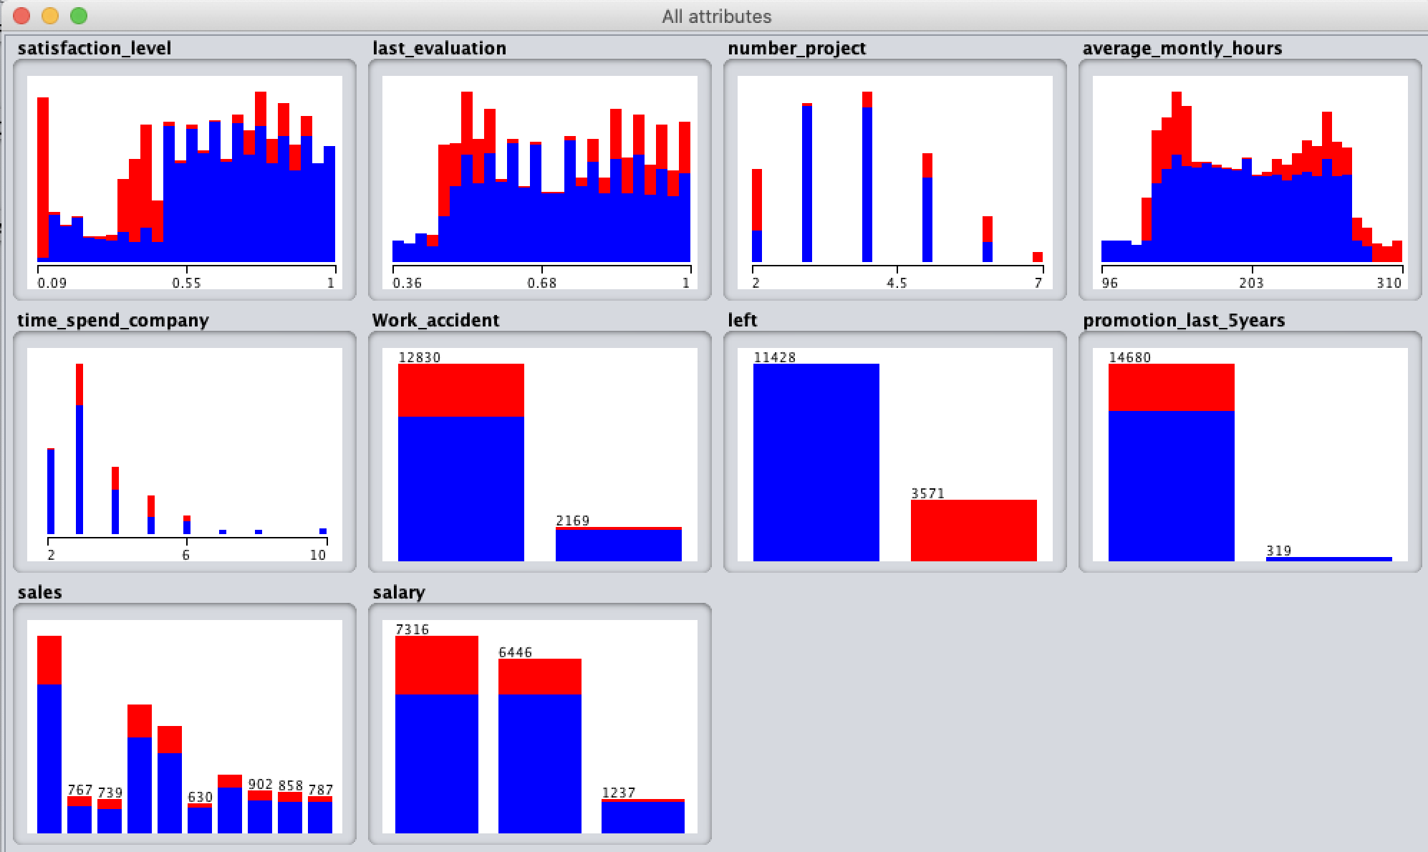
Data mining through weka
Left is the class - red shows employee left and blue shows employees still employed. Note: Convert following into nominal data type from numeric using the unsupervised > attribute filters: work_accident, left, promotion_last_5years, salary, sales
We can either select few of these to highlight some insights.
Less attrition if -
salary is high
Promoted in the last 5 years
No work accident
Satisfaction level is high
Red color - employees left
Blue color - employees employed
7316 - low salary
6446 - medium salary
1237 - high salary

